Slide 1


Recovery Patterns of Coded-Wire Tagged Spring Chinook Salmon in the Upper Willamette River Basin
David S. Hewlett
Cameron S. Sharpe
Oregon Department of Fish and Wildlife
Corvallis Research Laboratory

Slide 2
Introduction
Methods
Results
Summary
Questions
Goals:
What impact does release timing have on adult returns?
Is straying a concern for UWR hatcheries?
Objectives:
1a. Calculate smolt to adult returns (SARs)
1b. Estimate age structure of returning adults
2. Estimate homing/stray rates
Notes:
Goal
1. Look at the impact of release timing on fall/sub-yearling vs spring/yearling releases
2. Look at stray/homing rates and determine if straying is a concern for UWR hatcheries.
Objectives
The two metrics I used to evaluate impact of release timing on returning adults were SARs and the age structure
The second objective of this project was to estimate stray and homing rates of UWR hatchery fish, and compare them to other known stray rates.
An important clarification for this analysis is that I defined SARs as the number of fish that return to their target hatchery. The standard definition for SARs reflects smolt to adult survival at all. So the difference here is my SARs will be artificially low because they only include hatchery recoveries, but these rates will still be effective for comparisons between release groups.

Slide 3
Introduction
Methods
Results
Summary
Questions
RMIS* query
  Willamette releases and recoveries
  AD & CWT ChS only
  221,970 recoveries of 1,089 releases
Filter:
  Brood years 2000-2008
  Standard release/recoveries:
    Standard release location
    Recovered at target hatchery
    Nov., Feb., Mar., and Apr. release timing
  11,011 recoveries of 107 releases
*Regional Mark Information System (RMPC.org)
Notes:
Queried RMIS for
all Willamette releases and recoveries.
Only included AD+CWT because recoveries of non-AD clipped, CWT’d fish was inconsistent
>200K recoveries of >1K releases
Filter
Brood years 2000-2008, because brood year 1999 was the last brood year done by Mark Lewis and William Murray for the ODFW’s Annual Stock Assessment. and 2013 is the last group of 5-year old returns.
Defined: Standard release recoveries,
fish recovered at the hatchery in the subbasin they were released in
Ex: Fish released into the mainstem Mckenzie River, and subsequently recovered at McKenzie Hatchery hatchery
And standard release timing because that’s the objective
Downloaded everything because this was an exploratory project and I wanted to have ALL possible factors included.

Slide 4
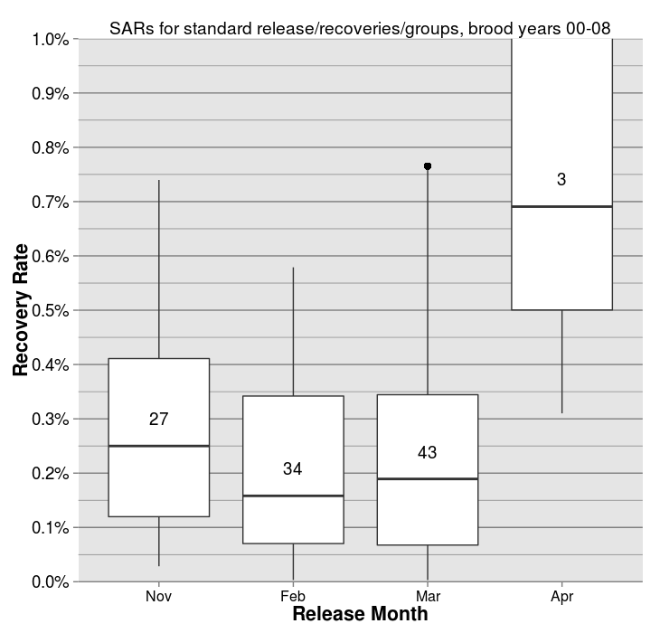
Willamette basin SARs
Introduction
Methods
Results
Summary
Questions
= N
43 tag codes
~4000 recoveries
Brood years 00-08
Run years 03-13
4 hatcheries
Mainstem releases
Recovered at “target” hatchery
Released in March
Notes:
Describe graph
All upper Willamette hatcheries
Recovery Rate: max = 1%
# = N value
27 = >3,500 recoveries
3 = > 500 recoveries
As a basin it shows fall released fish came back at a higher rate than spring releases.
Apr sample size was too small and we’ll see that on the next slide.
Lots of variability which means there’s more to it than release timing.
Because I downloaded EVERYTHING at the beginning Expanded brood years to include 1990-1999

Slide 5
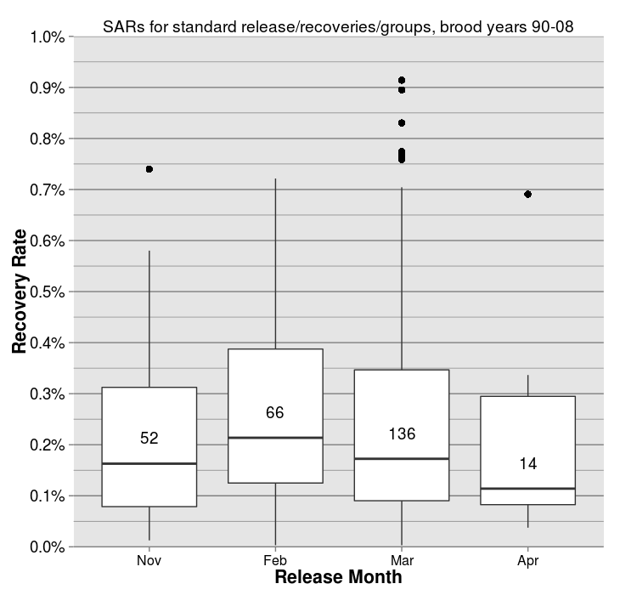
Willamette basin SARs
Introduction
Methods
Results
Summary
Questions
Notes:
As a basin it would appear that release timing has minimal impact on SARs at the basin level.
Further broke it down to the hatchery level
I have data for individual hatcheries but sample sizes are even smaller so I am only going to show two examples
because I think people want to see them,
and because they show evidence of subbasin specific trends that aren’t represented at the basin level.
?Between the two graphs we can infer that from 1990 we have been gradually increasing the return rate of November released fish.

Slide 6
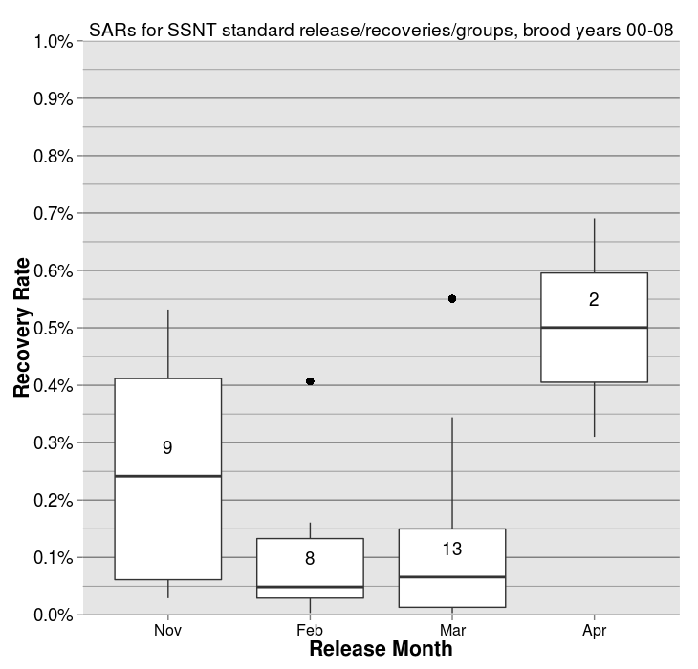
South Santiam Hatchery SARs
Introduction
Methods
Results
Summary
Questions
Notes:
So back to brood years 2000-2008, in the South Santiam basin the data suggests fall/sub-yearling releases return at a much higher rate than spring/yearling releases, with the exception of April releases.

Slide 7
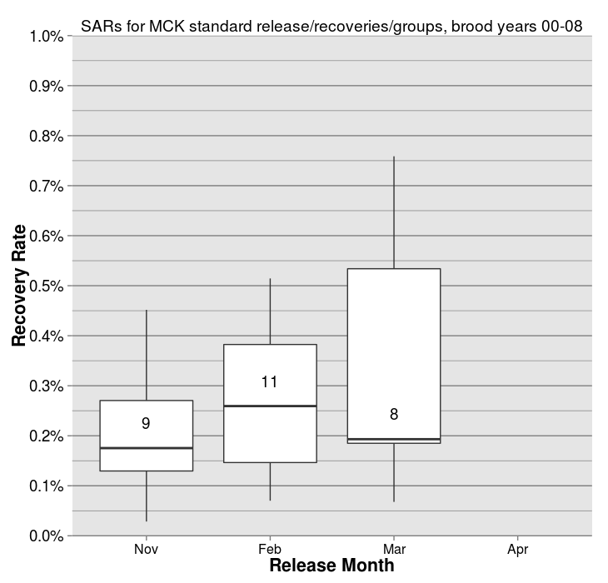
McKenzie Hatchery SARs
Introduction
Methods
Results
Summary
Questions
Notes:
Looking at McKenzie Hatchery it would appear spring/yearling releases return at a slightly higher rate than fall/sub-yearling releases.

Slide 8
Introduction
Methods
Results
Summary
Questions
Goals:
What impact does release timing have on adult returns?
Is straying a problem for UWR hatcheries?
Objectives:
1a. Calculate smolt to adult returns (SARs)
1b. Estimate age structure of returning adults
2. Estimate homing/stray rates
Notes:
Using the same data I looked at the age structure of each release group but calculated the age of each recovery based on brood year and run year, and calculating the % of each recovery that was age 1-6.
?wording?

Slide 9
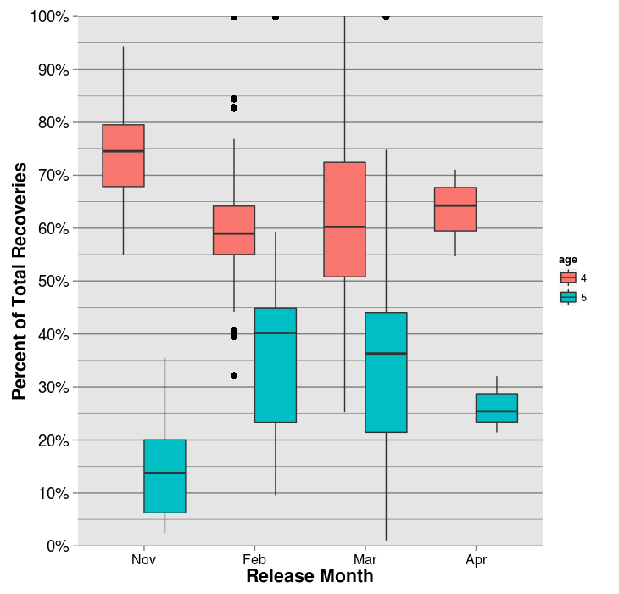
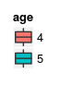
Upper Willamette basin age structure of CWT spring Chinook salmon by release timing, brood years 2000-2008
Introduction
Methods
Results
Summary
Questions
Notes:
Release month on x-axis
Percent of each release group that were age 4 and 5
This shows at the basin level, fall/sub-yearling releases return younger than spring/yearling releases return.
Again, if I expand this to include brood years 1990-1999…

Slide 10
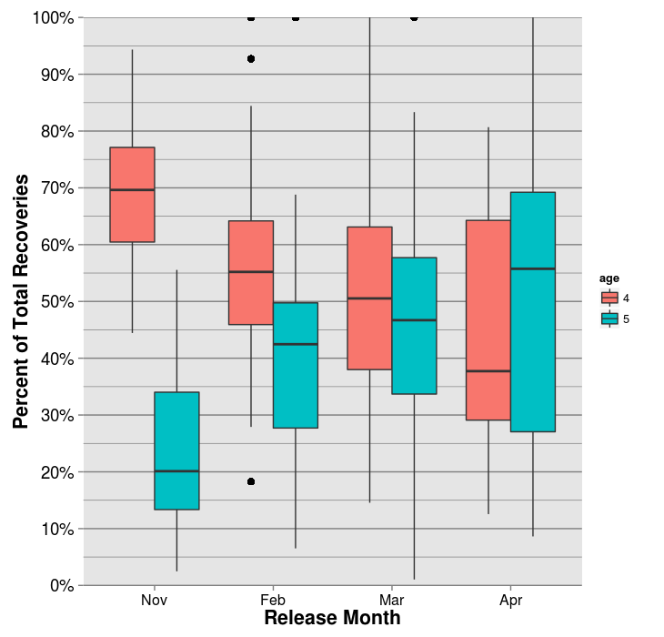
Upper Willamette basin age structure of CWT spring Chinook salmon by release timing, brood years 1990-2008
Introduction
Methods
Results
Summary
Questions
Notes:
The same trend is visible.

Slide 11
Introduction
Methods
Results
Summary
Questions
Goals:
What impact does release timing have on adult returns?
Is straying a problem for UWR hatcheries?
Objectives:
1a. Calculate smolt to adult returns (SARs)
1b. Estimate age structure of returning adults
2. Estimate homing/stray rates

Slide 12
Introduction
Methods
Results
Summary
Questions
RMIS query
  Willamette releases and recoveries
  AD & CWT ChS only
  221,970 recoveries of 1,089 releases
Filter:
  Brood years 2000-2008
  Std. release timing (Nov., Feb., Mar., and Apr)
  All releases and recoveries of UWR reared ChS
  32,266 recoveries of 167 releases
Classified recovery locations by type/subbasin
  Migratory fisheries, hatcheries, spawning grounds
Notes:
Used original RMIS query but filtered for:
Same brood years
Standard recovery timing to remove odd experimental releases (July)
All releases and recoveries of fish reared at upper Willamette hatcheries
Classified recovery locations by type (migratory fisheries (marine, columbia, willam, subbasin), hatchery, spawning grounds) and subbasin.
Combined the number of recoveries of a tag code, by recovery location type

Slide 13
Introduction
Methods
Results
Summary
Questions
Final disposition of coded wire tagged upper Willamette spring Chinook salmon
for brood years 2000-2008, by hatchery and release location
Hatchery | Release Location | Target Hatchery | Migratory Fisheries | Same Subbasin Spawning Grounds | Out of Subbasin Stray
Marion Forks | Detroit Reservoir | 22% | 68% | 4% | 6%
Marion Forks | North Santiam R. | 45% | 51% | 2% | 2%
South Santiam | South Santiam R. | 35% | 60% | 4% | 1%
McKenzie | McKenzie R. | 47% | 50% | 2% | 0%
Dexter Ponds | Middle Fork Willamette | 51% | 49% | 1% | 0%
Willamette | Middle Fork Willamette | 46% | 53% | 1% | 0%
Willamette | Blind Slough | 0% | 97% | 0% | 2%
Willamette | Clackamas River | 39% | 57% | 3% | 1%
Willamette | Molalla R. | 0% | 82% | 1% | 17%
Willamette | South Santiam R. | 23% | 70% | 6% | 1%
Notes:
Ordered by sub basin of rearing
Hatchery – where fish were reared
Release location
Target Hatchery – Where the fish are supposed to go. EX: Will. H. fish released in SSNT and CLACK.
“Same Subbasin Spawning Survey” recoveries should be considered “stray” and I’ll show that on my next slide. But, I separated them here for two reasons.
1. Some releases that don’t have “terminal recovery location”. For example, Molalla (1%) spawning survey recoveries.
2. I think there’s a difference between a fish that returns to the correct basin but does not select for the hatchery, and one that is in the wrong basin entirely.
Standard releases are highlighted
Especially knowledgeable folks in the room my notice that not all releases are listed, only ones I thought would be of interest.
Low hanging fruit here
Detroit release
Relatively high fisheries recoveries compared to hatchery recoveries
Relatively high stray rate compared to other releases
Interestingly enough most stray recoveries were at McKenzie and Clackamas hatcheries.
South Santiam
Contributes slightly larger proportion of fish to the fishery than other standard releases
Generally more fish stay out on spawning grounds in South Santiam than other basins
Maybe with new collection facility will increase homing?
Molalla
South Santiam stock, reared at Willamette Hat, and were direct released in Molalla. (not acclimated)
Recovered in every upper Willamette hatchery AND spawning grounds
Started acclimation program in 2013
Merge columns to calculate stray…

Slide 14
Introduction
Methods
Results
Summary
Questions
Stray rates of coded wire tagged upper Willamette spring Chinook salmon
for brood years 2000-2008, by hatchery and release location
Hatchery | Release Location | Target Hatchery and Migratory Fisheries | Stray
Marion Forks | Detroit Reservoir | 90% | 10%
Marion Forks | North Santiam R. | 96% | 4%
South Santiam | South Santiam R. | 95% | 5%
McKenzie | McKenzie R. | 98% | 2%
Dexter Ponds | Middle Fork Willamette | 99% | 1%
Willamette | Middle Fork Willamette | 99% | 1%
Willamette | Blind Slough | 97% | 3%
Willamette | Clackamas River | 96% | 4%
Willamette | Molalla R. | 83% | 17%
Willamette | South Santiam R. | 93% | 7%
Notes:
Generally speaking, Willamette reared fish go where they are supposed to, with the exception of Detroit Reservoir releases and Molalla direct releases.
Now, the Molalla release provide a great segue

Slide 15
Introduction
Methods
Results
Summary
Questions
Goals:
What impact does release timing have on adult returns?
  No impact on SARs at basin level
  Variable impact on SARs at subbasin level
  Fall/sub-yearling releases return younger than spring/yearling releases
Is straying a problem for UWR hatcheries?
  Not for standard releases
  Potential for unacclimated releases
Notes:
We demonstrated that
Release timing does not impact recovery rates at the basin level, but could at the subbasin level.
Release timing does impact the age structure of returning adults. Generally, fish released earlier return younger.
This coincides with a report by D.G. Hannkin for ODFW that showed fish that were released earlier returned younger and larger.
We also demonstrated that spring Chinook salmon reared at UWR hatcheries return to where they are supposed to.
With the exception of unacclimated, out of subbasin releases
Future research:
Does age impact recovery rate?
Does hatchery age structure mimic wild populations at the subbasin level?
Release timing impact stray rates?
Define stray as #of strays that contribute to hatchery stock.

Slide 16
Introduction
Methods
Results
Summary
Questions
New questions:
Does age impact recovery rate?
Does hatchery age structure mimic wild populations?
How does release timing impact stray rates?
Notes:
Future research:
Does age impact recovery rate?
Does hatchery age structure mimic wild populations at the subbasin level?
Release timing impact stray rates?

Slide 17
Introduction
Methods
Results
Summary
Questions
Acknowledgements
Micki Varney
Marc Johnson
Questions

Slide 19
Introduction
Methods
Results
Summary
Questions
Final disposition of coded wire tagged upper Willamette spring Chinook salmon
for brood years 2000-2008, by hatchery and release location
Hatchery | Release Location | Target Hatchery | Migratory Fisheries | Same Subbasin Spawning Grounds | Out of Subbasin Stray
Marion Forks | Detroit Reservoir | 22% | 68% | 4% | 6%
Marion Forks | Klaskanine R. | 0% | 94% | 0% | 6%
Marion Forks | North Santiam R. | 45% | 51% | 2% | 2%
South Santiam | South Santiam R. | 35% | 60% | 4% | 1%
McKenzie | McKenzie R. | 47% | 50% | 2% | 0%
Dexter Ponds | Middle Fork Willamette | 51% | 49% | 1% | 0%
Willamette | Middle Fork Willamette | 46% | 53% | 1% | 0%
Willamette | Blind Slough | 0% | 97% | 0% | 2%
Willamette | Clackamas River | 39% | 57% | 3% | 1%
Willamette | Fall Creek | 25% | 71% | 3% | 1%
Willamette | John Day R. | 0% | 94% | 0% | 6%
Willamette | Molalla R. | 0% | 82% | 1% | 17%
Willamette | South Santiam R. | 23% | 70% | 6% | 1%
Willamette | Tongue Pt. | 0% | 98% | 1% | 1%
Willamette | Youngs Bay | 0% | 100% | 0% | 0%

Slide 20
Introduction
Methods
Results
Summary
Questions
Stray rates of coded wire tagged upper Willamette spring Chinook salmon
for brood years 2000-2008, by hatchery and release location
Hatchery | Release Location | Target Hatchery and Migratory Fisheries | Stray
Marion Forks | Detroit Reservoir | 90% | 10%
Marion Forks | Klaskanine R. | 94% | 6%
Marion Forks | North Santiam R. | 96% | 4%
South Santiam | South Santiam R. | 95% | 5%
McKenzie | McKenzie R. | 98% | 2%
Dexter Ponds | Middle Fork Willamette | 99% | 1%
Willamette | Middle Fork Willamette | 99% | 1%
Willamette | Blind Slough | 97% | 3%
Willamette | Clackamas River | 96% | 4%
Willamette | Fall Creek | 96% | 4%
Willamette | John Day R. | 94% | 6%
Willamette | Molalla R. | 83% | 17%
Willamette | South Santiam R. | 93% | 7%
Willamette | Tongue Pt. | 98% | 2%
Willamette | Youngs Bay | 100% | 0%

